Slide 1

iNode-based File System
Computer System Engineering, Fall 2019. (IPADS, SJTU)
Seven layers abstraction
Yubin Xia

Slide 2
iNode based File System

Slide 3
File
A file has two key properties
It is durable & has a name
It is a high-level version of the memory abstraction
System layer implements files using modules from hardware layer
Divide-and-conquer strategy
Makes use of several hidden layers of machine-oriented names (addresses), one on another, to implement files
Maps user-friendly names to these files
Notes:
Everything is a file:
same operations: open, read, write, ioctl
same naming scheme

Slide 4
The Big Picture
User
App-1
App-2
App-3
OPEN("a.txt", "rw")
READ(…)
WRITE(…)
…
File System
Kernel
Disk Driver
READ(block-addr, buf)
WRITE(block-addr, buf)
Hardware
Memory
Disk

Slide 5
Abstraction: API of UNIX File System
OPEN, READ, WRITE, SEEK, CLOSE
FSYNC
STAT, CHMOD, CHOWN
RENAME, LINK, UNLINK, SYMLINK
MKDIR, CHDIR, CHROOT
MOUNT, UNMOUNT
….

Slide 6
7 software layers

Slide 7
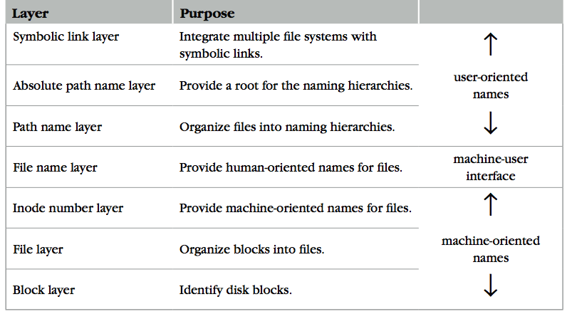
The Naming Layers of the UNIX FS (version 6)

Slide 8

L1: Block Layer
Block num
Disk
Block
Mapping: block number -> block data
How to know the size of block?
How to know which block is free?
These metadata will also be stored on the same disk
Super block!

Slide 9
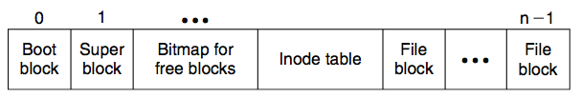
Super Block
Block num
Disk
Block
One superblock per file system
Kernel reads superblock when mount the FS
Superblock contains
Size of the inode list
Number of free inodes
A list of free inodes
Index to next free inode
Size of the blocks
Number of free blocks
A list of free blocks
Index to next free block
Lock field for free block and free inode lists
Flag to indicate modification of superblock
...
Notes:
We need to organize the blocks to store larger size data

Slide 10
L1: Block Layer
Block num
Disk
Block
Block size: a trade-off
Neither too small or too big
Q: What will happen if the block size is too small? What if too big?

Slide 11
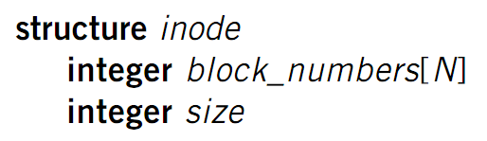
L2: File Layer
File
(inode)
Block num
Disk
Block
File requirements
Store items that are larger than one block
May grow or shrink over time
A file is a linear array of bytes of arbitrary length
Record which blocks belong to each file
inode (index node)
A container for metadata about the file

Slide 12
inode for Larger Files
File
(inode)
Block num
Disk
Block
block
indirect block
double indirect block
triple indirect block
inode
Notes:
with a 512 byte block size, and 4 byte block pointers, each indirect block can consist of 128 (512 / 4) pointers.
For one double indirect block: (128*128*512) / (1024*1024)

Slide 13
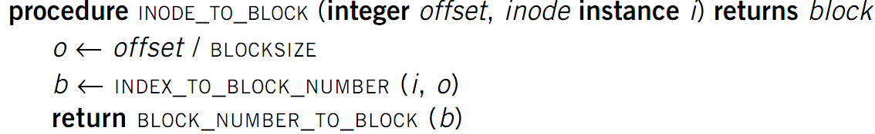
L2: File Layer
File
(inode)
Block num
Disk
Block
Given an inode, can map a block index number (of a file) -> block number (of a disk)
Index number: e.g., the 3rd block of a file is number 78

Slide 14
L3: inode Number Layer
Inode num
File
(inode)
Block num
Disk
Block
Mapping: inode number -> inode
inode table: at a fixed location on storage
inode number is the index of inode table
Track which inode number are in use, e.g. free list, a field in inode

Slide 15
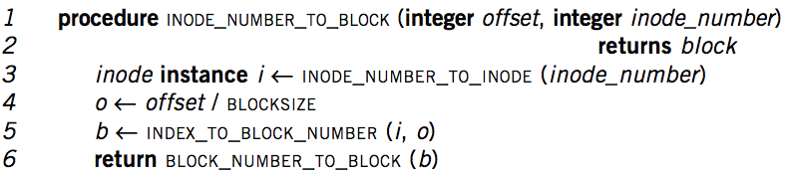
Put Layers so far Together
Inode num
File
(inode)
Block num
Disk
Block
inode number is enough to operate a file
Needs more user-friendly name
Numbers are convenient names only for computer
Numbers change on different storage device

Slide 16
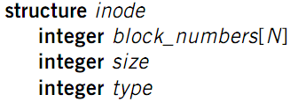
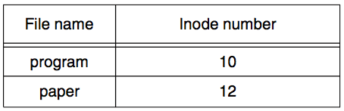
L4: File Name Layer
File
name
Inode num
File
(inode)
Block num
Disk
Block
File name
Hide metadata of file management
Files and I/O devices
Mapping
Mapping table is saved in directory
Default context: current working directory
Context reference is also an inode number
The inode number of current directory is also a file
Max length of a file name is 14 bytes in UNIX version 6
This is what a directory looks like
Notes:
CHDIR can set working directory

Slide 17
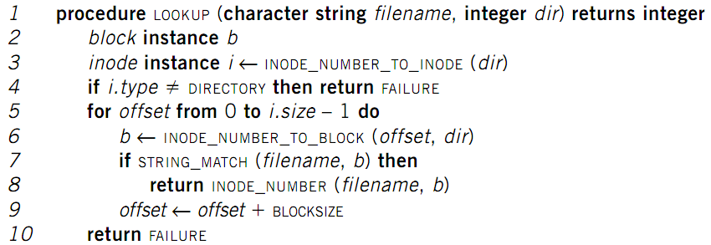
LOOKUP in a Directory
File
name
Inode num
File
(inode)
Block num
Disk
Block
Name compare method: STRING_MATCH
LOOKUP("program", dir) will return 10
Next Problem: what if too many files?

Slide 18
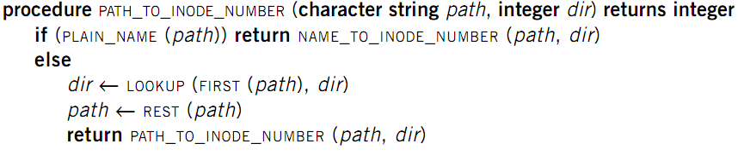
L5: Path Name Layer
File
name
Inode num
File
(inode)
Block num
Disk
Block
Path name
Hierarchy of directories and files
Structured naming: E.g. "projects/paper"
PLAIN_NAME() returns true if no ‘/’ in the path
Context: the working directory

Slide 19
Links
File
name
Inode num
File
(inode)
Block num
Disk
Block
Path name
LINK: shortcut for long names
LINK("Mail/inbox/new-assignment", "assignment")
Turns strict hierarchy into a directed graph
Users cannot create links to directories -> acyclic graph
Different names, same inode number
UNLINK
Remove the binding of filename to inode number
If UNLINK last binding, put inode/blocks to free-list
A reference counter is needed

Slide 20
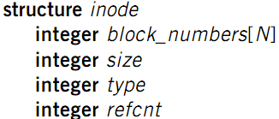
Links
File
name
Inode num
File
(inode)
Block num
Disk
Block
Path name
Reference count
An inode can bind multiple file names
+1 when LINK, -1 when UNLINK
A file will be deleted when reference count is 0
No cycle allowed
Except for ‘.’ and ‘..’
Naming current and parent directory with no need to know their names

Slide 21
No Cycle for LINK
File
name
Inode num
File
(inode)
Block num
Disk
Block
Path name
/
/
/
a
a
a
25:1
25:2
25:1
b
c
b
c
b
/a/b is a directory
The refcnt of a is 1
a’s inode num is 25
LINK ("/a/b/c", a")
Cause a cycle!
Refcnt of a is 2
UNLINK ("/a")
Refcnt of a is 1, so the inode 25 is not deleted
Now inode 25 is dis-connected from graph

Slide 22
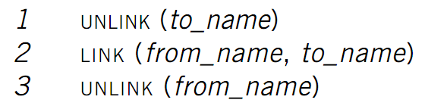
Renaming - 1
File
name
Inode num
File
(inode)
Block num
Disk
Block
Path name
Text edit usually save editing file in a tmp file
Edit in .a.txt.swp, then rename .a.txt.swp to a.txt
What if the computer fails between 1 & 2?
to_name will be lost, which surprises the user
Need atomic action in chap-9

Slide 23

Renaming - 2
File
name
Inode num
File
(inode)
Block num
Disk
Block
Path name
Weaker specification without atomic actions
1. Changes the inode number in for to_name to the inode number of from_name
2. Removes the directory entry for from_name
If fails between 1 & 2
Must increase reference count of from_name’s inode on recovery
If to_name already exist
It will always exist even if machine fails between 1 & 2

Slide 24

L6: Absolute Path Name Layer
Absolute path
File
name
Inode num
File
(inode)
Block num
Disk
Block
Path name
HOME directory
Every user’s default working directory
Problem: no sharing of HOME files between users
Context: the root directory
A universal context for all users
Well-known name: ‘/’
Both ‘/.’ and ‘/..’ are linked to ‘/’

Slide 25
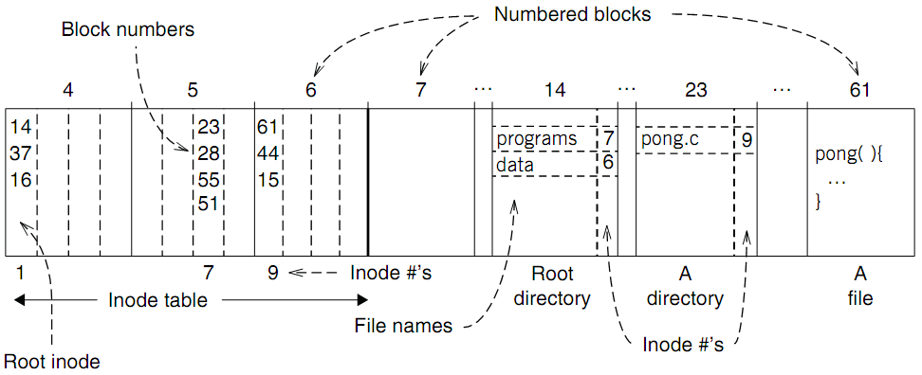
An Example: Find Blocks of "/programs/pong.c"

Slide 26
An Example: Find Blocks of "/programs/pong.c"
‘/’ root directory: inode is 1

Slide 27
An Example: Find Blocks of "/programs/pong.c"
Find the first directory in ‘/’ by block number

Slide 28
An Example: Find Blocks of "/programs/pong.c"
Find ‘/programs’ by comparing name

Slide 29
An Example: Find Blocks of "/programs/pong.c"
Find ‘/programs’ inode by its inode number 7

Slide 30
An Example: Find Blocks of "/programs/pong.c"
Find the first file in ‘/programs/’

Slide 31
An Example: Find Blocks of "/programs/pong.c"
Find ‘/programs/pong.c’ by comparing its name

Slide 32
An Example: Find Blocks of "/programs/pong.c"
Find inode of ‘/programs/pong.c’ by the inode number 9

Slide 33
An Example: Find Blocks of "/programs/pong.c"
Find block number of ‘/programs/pong.c’

Slide 34
An Example: Find Blocks of "/programs/pong.c"
Find data of block 61 by its block number
And data of block 44 & 15

Slide 35
L7: Symbolic Link Layer
Symbolic link
Absolute path
File
name
Inode num
File
(inode)
Block num
Disk
Block
Path name
MOUNT
Record the device and the root inode number of the file system in memory
Record in the in-memory version of the inode for "/dev/fd1" its parent’s inode
UNMOUNT undoes the mount
Change to the file name layer
If LOOKUP runs into an inode on which a file system is mount, it uses the root inode of that file system for the lookup

Slide 36
L7: Symbolic Link Layer
Symbolic link
Absolute path
File
name
Inode num
File
(inode)
Block num
Disk
Block
Path name
Name files on other disks
Inode is different on other disks
Supports to attach new disks to the name space
Two options
Make inodes unique across all disks
Create synonyms for the files on the other disks
Soft link (symbolic link)
SYMLINK
Add another type of inode

Slide 37
Other Choices than inode
Method-1:
Use continue blocks
Re-allocate if the file expands
E.g., data in memory
Why not?
How to integrate different FS?
vnode (will discuss later)
Interface is similar with inode
Method-2: Use Linked List
Each block links to its next block
Use special one as EOF (End of File)
E.g., FAT32
Why not?

Slide 38
FAT (File Allocation Table) File System
File is collection of disk blocks
FAT is linked list 1-1 with blocks
File Number is index of root of block list for the file
File offset (o = < B, x > )
Follow list to get block #
Unused blocks ⬄ FAT free list
FAT
Disk Blocks
file number
0:
0:
31:
File 31, Block 0
File 31, Block 1
free
File 31, Block 2
N-1:
N-1:
memory

Slide 39
FAT Properties
File is collection of disk blocks
FAT is linked list 1-1 with blocks
File Number is index of root of block list for the file
File offset (o = < B, x > )
Follow list to get block #
Unused blocks ⬄ FAT free list
Ex: file_write(31, < 3, y >)
Grab blocks from free list
Linking them into file
FAT
Disk Blocks
file number
0:
0:
31:
File 31, Block 0
File 31, Block 1
File 31, Block 3
free
File 31, Block 2
N-1:
N-1:
memory

Slide 40
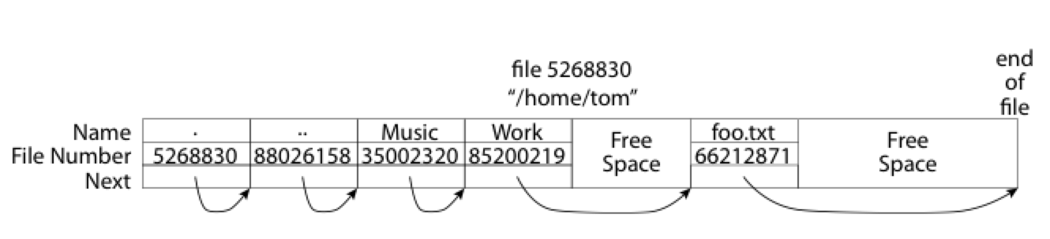
What about the Directory in FAT?
Essentially a file containing <file_name: file_number> mappings
Free space for new entries
In FAT: file attributes are kept in directory (!!!)
Each directory a linked list of entries
Q: Where to find root directory ( "/" )?

Slide 41
Question
What are the differences between inode and FAT?
Support hard link? Soft link?

